Slide 1




Open BOML #2
BATCH 2
Open Belajar Online Machine Learning
Python for Machine Learning
ONLINE @ZOOM
Muhammad Yunus
@yunusmuhammad007
Muhammad-Yunus

Slide 2
CONTENTS
1
Dasar Pemrograman Python
2
Struktur Data pada Python
3
Dasar Numpy
4
Operasi Matrix
5
Dasar Pandas

Slide 3
Dasar Pemrograman Python
1

Slide 4
Python input & output
Variable
Operator aritmatika,
Operator penugasan,
Operator pembanding,
Operator logika
Percabangan if else
Perulangan for
Perulangan while

Slide 5
Struktur Data pada Python
2

Slide 6
Struktur data list
Struktur data tuple
Struktur data set
Struktur data dictionary
Built-in function

Slide 7
Dasar Numpy
3

Slide 8
Create vector / matrix
Vector data type
Built-in function
Describe Vector
Reshape Vector

Slide 9
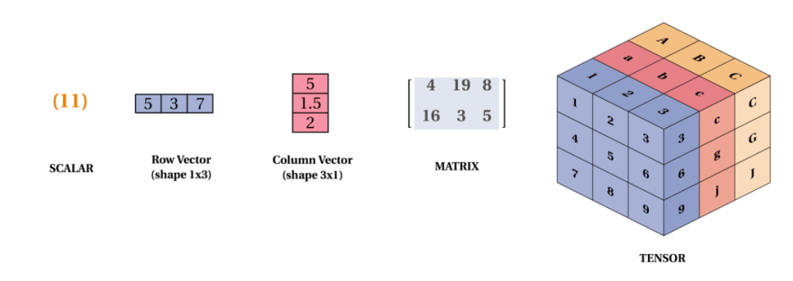
Vector vs Matrix vs Tensor

Slide 10
Matrix Operation
4

Slide 11
Penjumlahan, Pengurangan matrix
Perkalian dan pembagian scalar
Perkalian Matrix biasa
Transpose matrix
Dot product
Generate Random value

Slide 12
Dasar Pandas
5

Slide 13
Read data
Describe Dataframe
Select Dataframe & Series
Filter Dataframe
Sorting Dataframe
Visualization

Slide 14
Sesi Diskusi

Slide 15
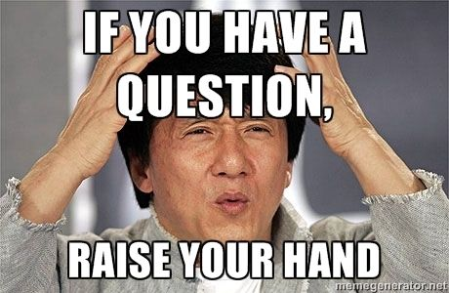

Slide 16
Thank you
PART 1

